Slide 1

Numerical Summaries of Data
Chapter 3

Slide 2
Objectives
Read book sections 3.1 – 3.3.
❏ Know by heart each symbol we learn in this chapter. We will use them all semester.
❏ Calculate each parameter and statistic using R Studio.
❏ Understand how and when to use the Empirical Rule and Chebyshev’s Inequality.
❏ Create box plots in R Studio.
After we graph a list of data values, then we can summarize them numerically. We calculate measures of center, measures of spread, and measure of position. Descriptive statistics are all about “painting a picture.” Sample statistics are often used to estimate population parameters that we cannot know for certain.

Slide 3
Topics
Measures of Center
  Mean
  Median
  Mode
Measures of Spread
  Range
  Variance
  Standard Deviation
  Empirical Rule
  Chebyshev’s Inequality
Measures of Position
  Z-Scores
  Quartiles
  Percentiles
  5-Number Summary
  IQR and Outliers
  Box Plots

Slide 4
Measures of Center
Measures of center tell us the central tendencies of a data set.
Around what value(s) are the observations balanced?

Slide 5

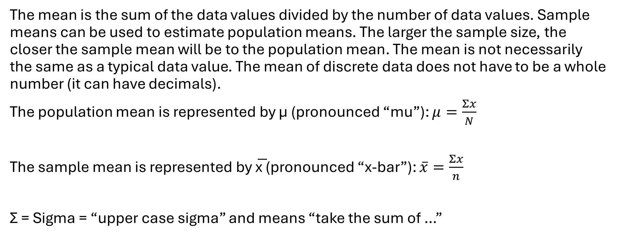
The Mean
The mean is the sum of the data values divided by the number of data values. Sample means can be used to estimate population means. The larger the sample size, the closer the sample mean will be to the population mean. The mean is not necessarily the same as a typical data value. The mean of discrete data does not have to be a whole number (it can have decimals).
The population mean is represented by µ (pronounced “mu”): $μ=\frac{Σx}{N}$
The sample mean is represented by x̅ (pronounced “x-bar”): $\overline{x}=\frac{Σx}{n}$
Σ = Sigma = “upper case sigma” and means “take the sum of …”

Slide 6
The Median
The median splits the data set in half. After the data values have been arranged in ascending order, it is the middle value.
If n is odd, then the median is the middle number.
If n is even, then the median is the average of the two middle numbers.

Slide 7
Mean vs. Median
How many data values influence the mean? How many data values influence the median?
The median is resistant to extreme values. The highest and lowest values do not significantly pull the median in either direction. The mean is NOT resistant to extreme values. A relatively high or relatively low number will pull the mean up or down accordingly. Because the median is resistant, it is a better measure of center to rely on for skewed data.
Example: Find the mean and median of both groups of income.
Group 1:
$25,000 $31,000 $34,000 $44,000 $56,000
Group 2:
$25,000 $31,000 $34,000 $44,000 $800,000

Slide 8
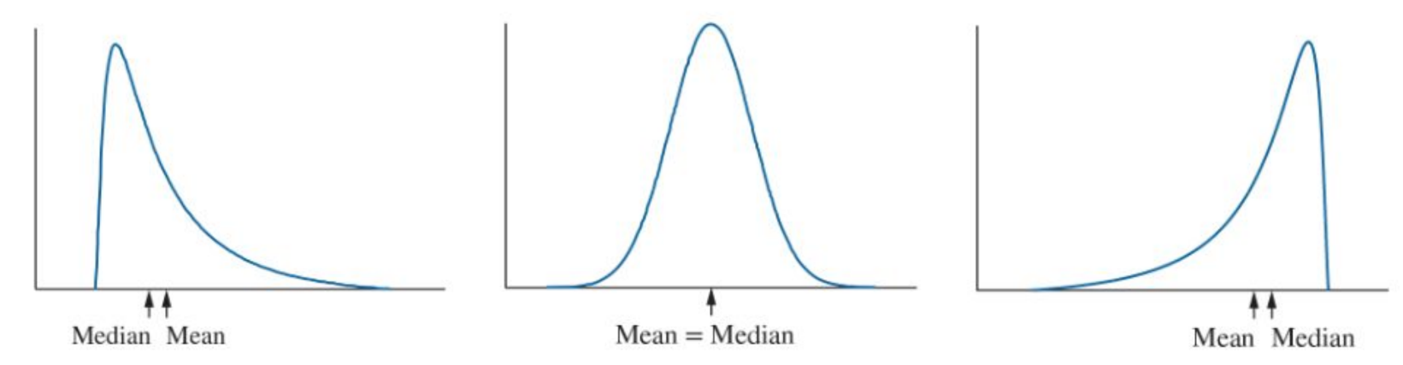
Mean vs. Median in a Picture
Right-skewed distributions: mean > median. Symmetric distributions: mean = median. Left-skewed distributions: mean < median.

Slide 9
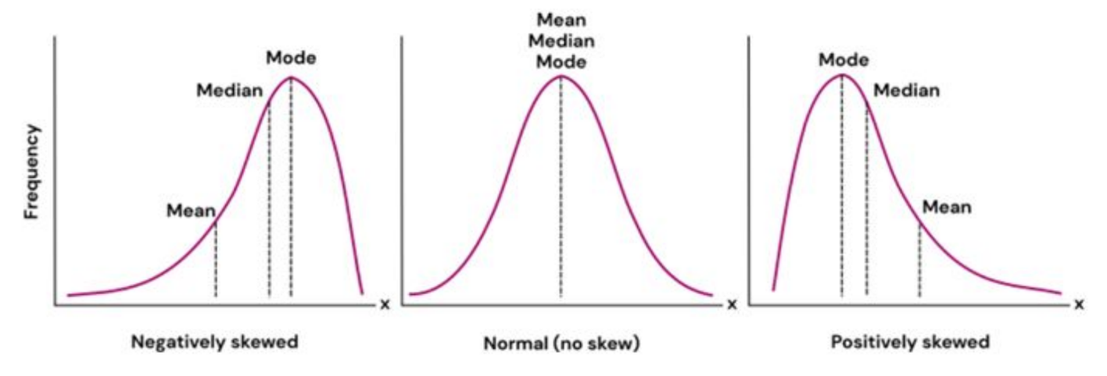
The Mode
The mode is the most frequent or most common data value. It can be found for both quantitative and qualitative data. There can be multiple modes if they are tied in count for most frequent value. Visually, the mode is the peak.

Slide 10
Practice (using mtcars)
What is the mean of the variable weight (wt)?
What is the median of the variable displacement (disp)?
What is the mode of the variable gear

Slide 11
Measures of Dispersion
Measures of spread tell us how dispersed, spread out, or varied a data set it.

Slide 12
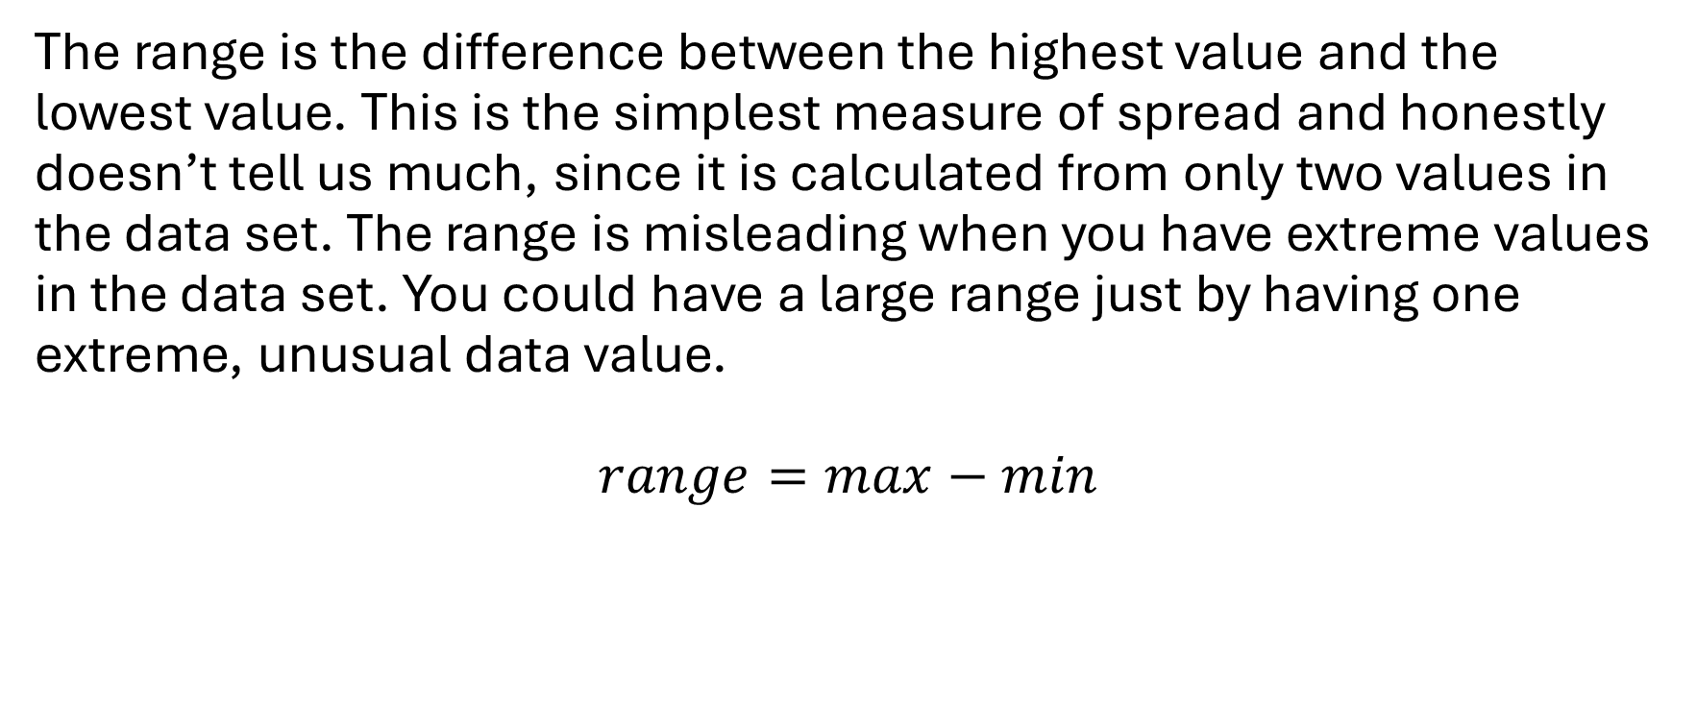
The Range
The range is the difference between the highest value and the lowest value. This is the simplest measure of spread and honestly doesn’t tell us much, since it is calculated from only two values in the data set. The range is misleading when you have extreme values in the data set. You could have a large range just by having one extreme, unusual data value.
$$range=max−min$$

Slide 13
Range Practice
The range of some variable is 150 and the minimum value is 79. What is the maximum value?
Can the range of a variable ever be 0?
Can the range of a variable ever be a negative number?
Look at vectors b1 and b2. Which one seems to have a higher level of variability?
b1 <- c(1, 5, 7, 7, 7, 7, 7, 7, 7, 7, 20)
b2 <- c(1, 3, 5, 9, 13, 15, 16, 17, 19, 20)
Calculate the range of both vectors.

Slide 14
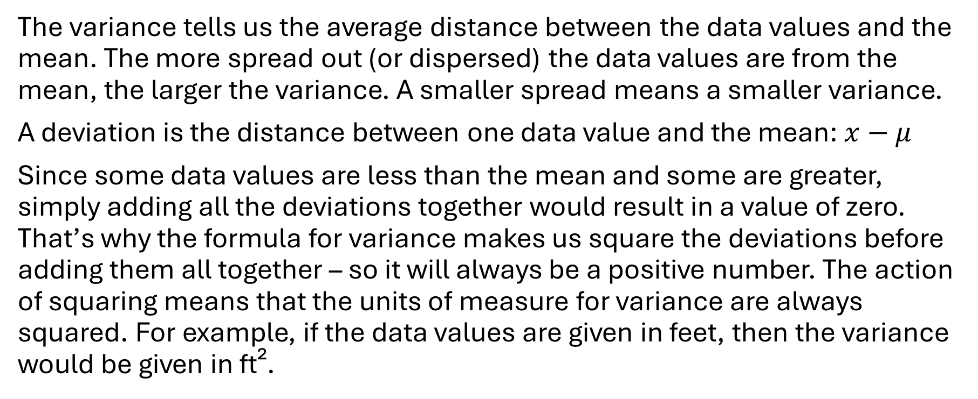
Variance
The variance tells us the average distance between the data values and the mean. The more spread out (or dispersed) the data values are from the mean, the larger the variance. A smaller spread means a smaller variance.
A deviation is the distance between one data value and the mean: $x−μ$
Since some data values are less than the mean and some are greater, simply adding all the deviations together would result in a value of zero. That’s why the formula for variance makes us square the deviations before adding them all together – so it will always be a positive number. The action of squaring means that the units of measure for variance are always squared. For example, if the data values are given in feet, then the variance would be given in ft².

Slide 15
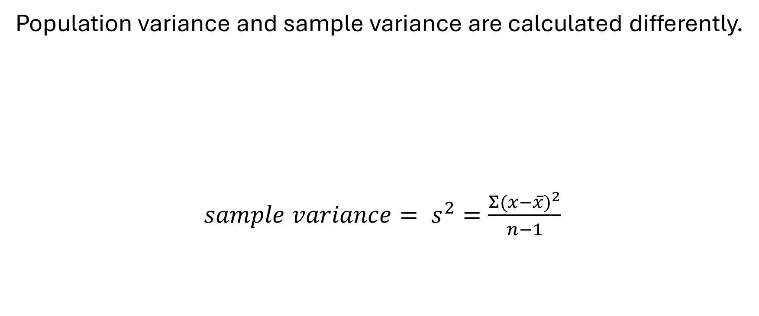
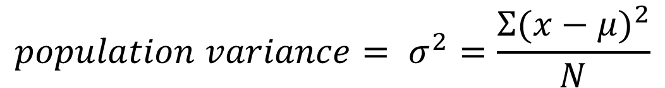
The Variance, continued
Population variance and sample variance are calculated differently.
$sample variance= s^{2}=\frac{Σ{(x−\overline{x})}^{2}}{n−1}$
$$population variance= σ^{2}=\frac{Σ{(x−μ)}^{2}}{N}$$

Slide 16
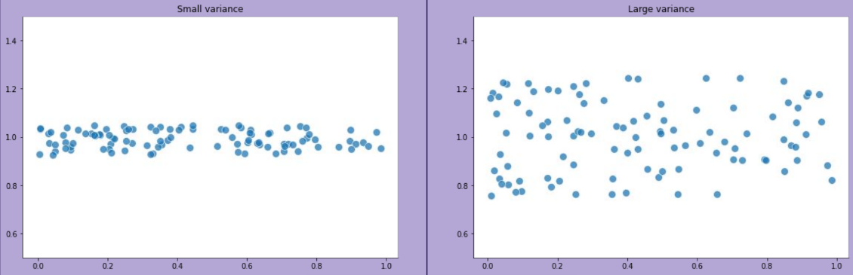
The Variance, visually

Slide 17
The Variance, continued
A computer does not know whether your data values make up an entire population or just a sample. So, it’s up to you to choose the correct formula/function.
The deviations from the sample mean are smaller than the deviations from the population mean. We correct this difference by dividing it by n-1 rather than by n. The quantity n–1 is called the degrees of freedom for sample variance.
The sum of the deviations will always add up to zero. That means if we know the first n-1 deviations, we can figure out the last one. Another way to say degrees of freedom is “the number of data values that are free to change.” Video Link Watch this short video about degrees of freedom if you want to learn more. I recommend that you skip to 1:18.

Slide 18
Variance Practice
Compare the two vectors again (from slide #11):
Which has a larger sample variance?
Can a data set ever have a variance of 0?
Can it have a negative variance?
Which do you think would have a smaller variance?
  a. The distribution of hours worked in a day.
  b. The distribution of income earned in a day.

Slide 19

The Standard Deviation
Since the variance is given in squared units, it can be hard to interpret the value. We can take the variance one step further and calculate the standard deviation, so that our measure of spread will be in the data’s original units of measure.
The standard deviation is the square root of the variance. Likewise, the variance is the standard deviation squared.
$$population standard deviation=\text{sigma}= σ=\sqrt{σ^{2}}$$
$$sample standard deviation=\text{s}=\sqrt{s^{2}}$$

Slide 20
Standard Deviation Practice
Are the variance and standard deviation resistant to extreme values?
True or false: Given that a data set is measured in gallons, the standard deviation would be shown in gallons² and the variance would be shown in gallons.
Which population would you expect to have a larger standard deviation?
  a. The heights of men ages 40-50.
  b. The heights of children ages 8-12.

Slide 21
The Empirical Rule (aka the 68 - 95 - 99.7 Rule)
We can approximate the shape of a histogram with a curved line. This will give us a general shape of the distribution of some population. If a population distribution is unimodal and approximately symmetrical, then we can call it bell-shaped. When a histogram/distribution is bell-shaped, we can use the Empirical Rule to understand the spread of the data values.
Roughly 68% of the data values are within one standard deviation of the mean.
Roughly 95% of the data values are within two standard deviations of the mean.
Roughly 99.7% of the data values are within three standard deviations of the mean.
Note that 100% of the data values are underneath the curve, which technically extends forever from negative infinity to positive infinity.

Slide 22
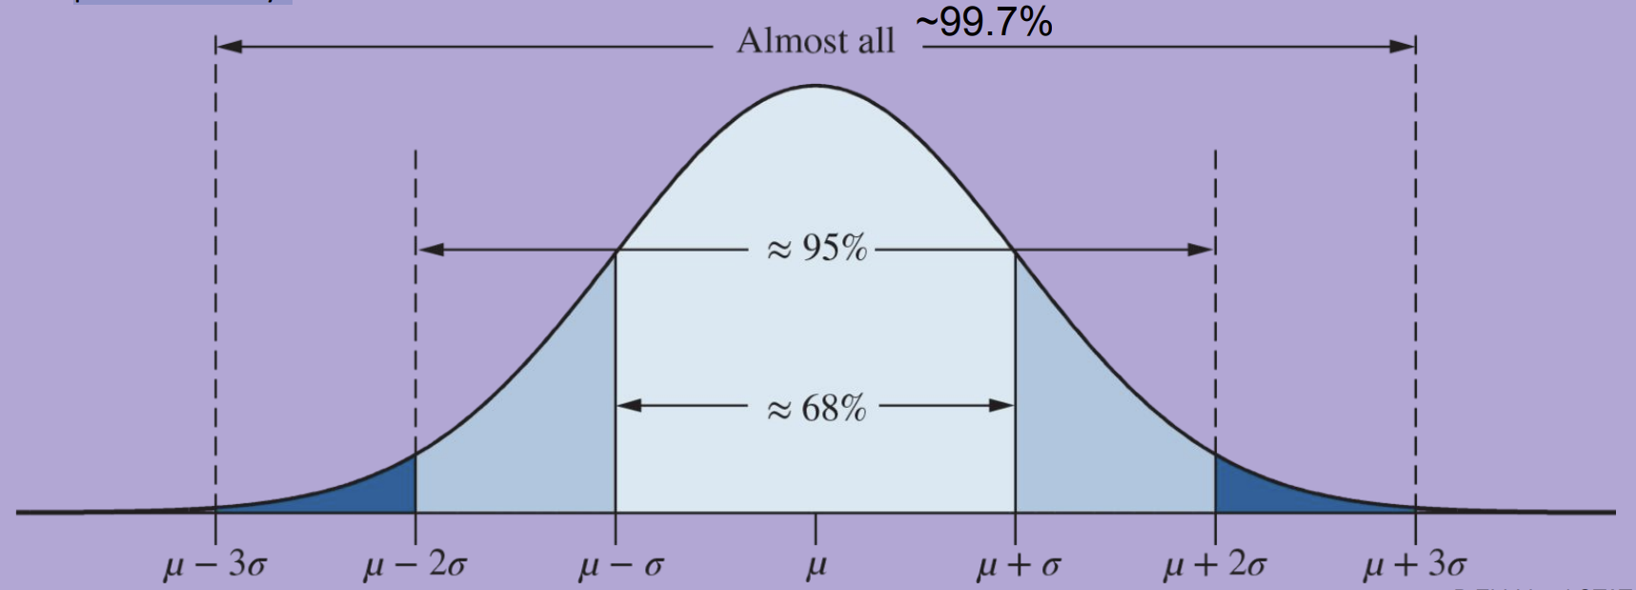
Empirical Rule Visual

Slide 23
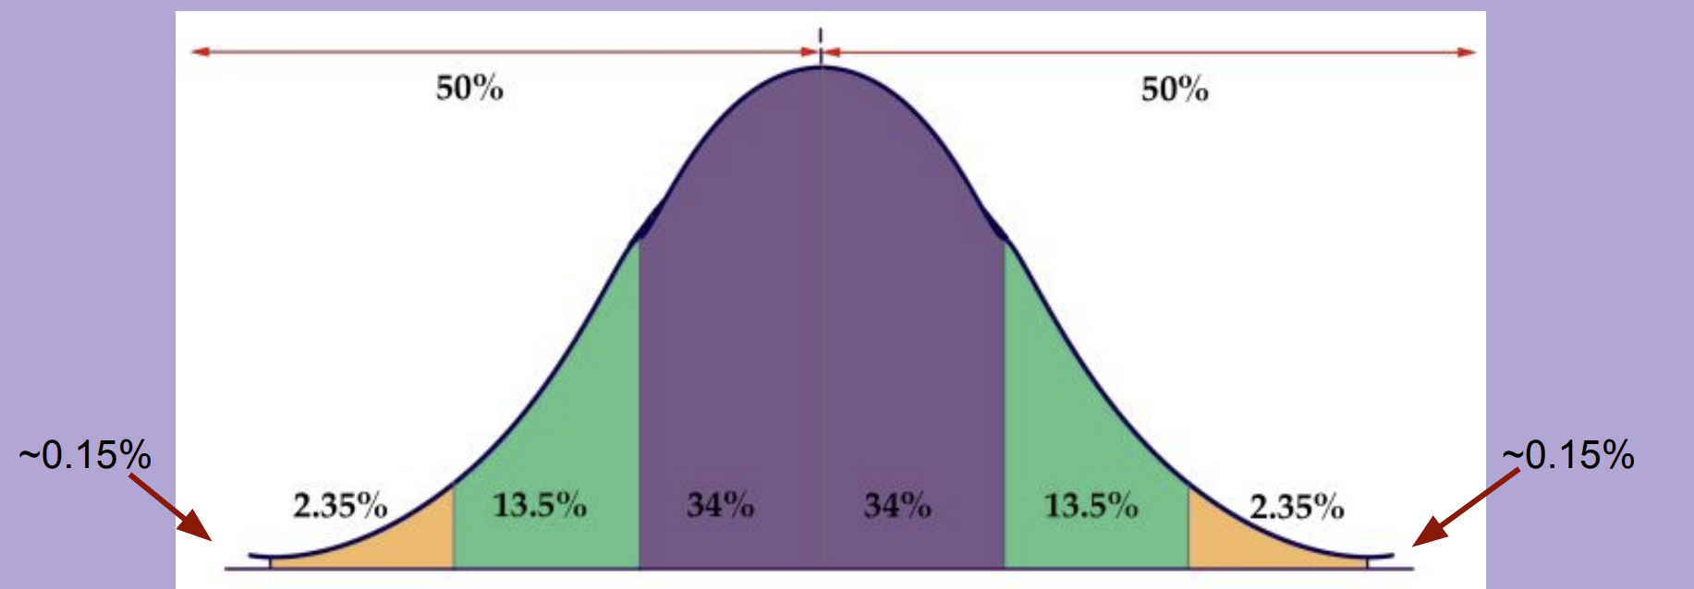
Empirical Rule Percentages
If a distribution is NOT bell-shaped, then we cannot rely on the Empirical Rule to estimate the spread of the distribution. Bell-shaped means it has to be both symmetric and unimodal.

Slide 24
Yoshi Example
The amount of fruit that Yoshi can eat in one day follows a bell-shaped distribution with a mean of 112 pounds and a standard deviation of 4 pounds.
Complete the Empirical Curve with cut-off values.
Approximately 95% of the data values are between which two numbers?
Approximately half of the data values are greater than which number?
Approximately what percentage of data values are between 108 pounds and 116 pounds?
… Between 100 pounds and 124 pounds?
… Greater than 120 pounds?
… Less than 108 pounds?

Slide 25
Netherworld Example
The amount of time that guests spend in Netherworld Haunted House follows a unimodal and symmetric distribution with a mean of 42.3 minutes and a standard deviation of 6.08 minutes. Complete the following picture and answer the questions below.
What data value is 2 standard deviations above the mean?
What data value is 3 standard deviations below the mean?
Roughly 68% of the guests spend between ______ and ______ minutes.
Approximately what percentage of guests spend between 48 and 60 minutes?
Approximately what percentage of guests spend less than half an hour?

Slide 26
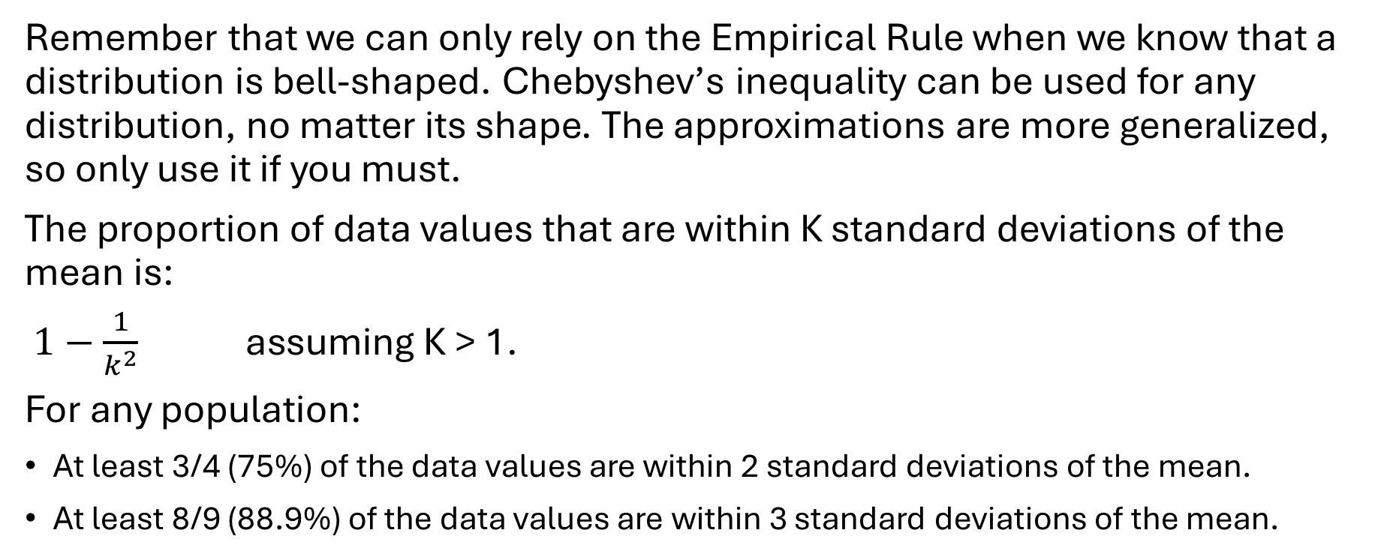
Chebyshev’s Inequality
Remember that we can only rely on the Empirical Rule when we know that a distribution is bell-shaped. Chebyshev’s inequality can be used for any distribution, no matter its shape. The approximations are more generalized, so only use it if you must.
The proportion of data values that are within K standard deviations of the mean is:
$1−\frac{1}{k^{2}}$ assuming K > 1.
For any population:
At least 3/4 (75%) of the data values are within 2 standard deviations of the mean.
At least 8/9 (88.9%) of the data values are within 3 standard deviations of the mean.

Slide 27
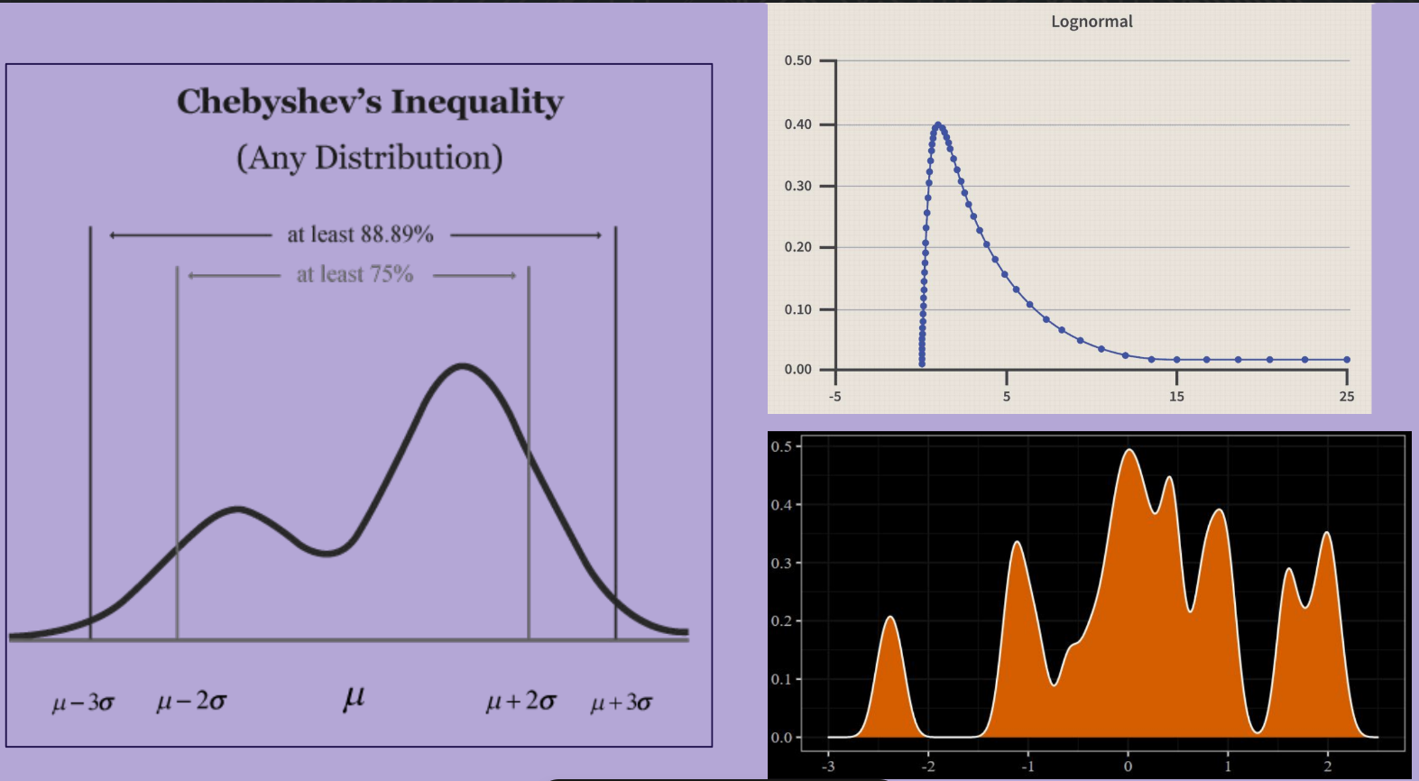
Chebyshev’s Visual

Slide 28
Aircraft Example
The population of a certain bolt used in building aircrafts follows a negatively skewed distribution with a mean of 125.01 mm and standard deviation of 1.26 mm.
At least what percentage of the bolts will be between 122.49 and 127.53 mm?
At least what percentage of bolts will be between 121.23 and 128.79 mm?
Roughly how many bolts will fall within one standard deviation of the mean?

Slide 29
Exam Scores Example
The mean score of an Insurance Commission Licensure Examination is 75.11, with a standard deviation of 6.7. The distribution of scores is multimodal.
How do you know that we need to use Chebyshev’s inequality here?
What percentage of the data set lies between 61.71 and 88.51?
At least 88.9% of data values lie between which two scores?

Slide 30
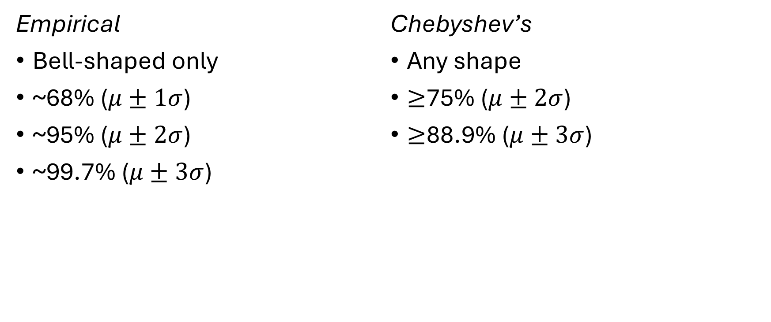
Summary: Empirical vs. Chebyshev’s
Empirical
Bell-shaped only
~68% ($μ±1σ$)
~95% ($μ±2σ$)
~99.7% ($μ±3σ$)
Chebyshev’s
Any shape
$≥$75% ($μ±2σ$)
$≥$88.9% ($μ±3σ$)

Slide 31
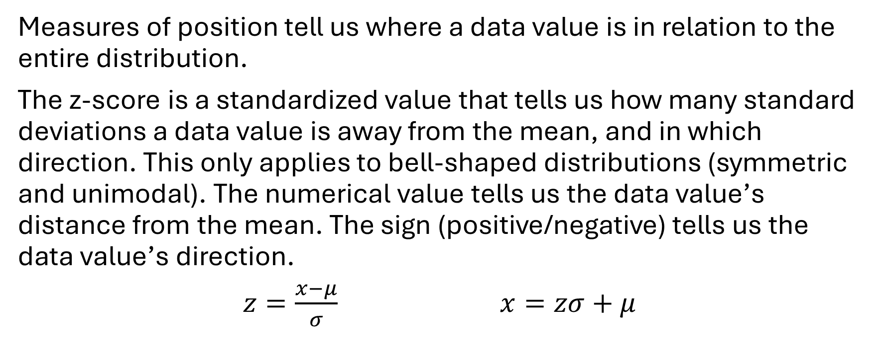
The z-score
Measures of position tell us where a data value is in relation to the entire distribution.
The z-score is a standardized value that tells us how many standard deviations a data value is away from the mean, and in which direction. This only applies to bell-shaped distributions (symmetric and unimodal). The numerical value tells us the data value’s distance from the mean. The sign (positive/negative) tells us the data value’s direction.
$z=\frac{x−μ}{σ}$ $x=zσ+μ$

Slide 32
Heights Example
Adult men in the U.S. have a mean height of 69.4 inches with a standard deviation of 3.1 inches. Adult women in the U.S. have a mean height of 63.8 inches with a standard deviation of 2.8 inches. Both population distributions follow a bell-curve.
What is the z-score for a man who is 67 inches tall?
What is the z-score for a woman who is 67 inches tall?
Who is taller relative to their population – the man or the woman?
How tall is a woman whose z-score is -2.6?
How tall is a man whose z-score is 0.55?
What is the z-score for your height?

Slide 33
Z-Scores and the Empirical Rule
For bell-shaped distributions,
Approximately 68% of the data values will have a z-score between -1 and 1.
Approximately 95% of the data values will have a z-score between -2 and 2.
Approximately 99.7% of the data values will have a z-score between -3 and 3.
The distribution of z-scores has a mean of 0 and a standard deviation of 1. A great benefit of z-scores is that they help us compare data values from different populations, hence the standardized value. Standardization allows for comparisons to be fair, so we’re not comparing apples to oranges.

Slide 34
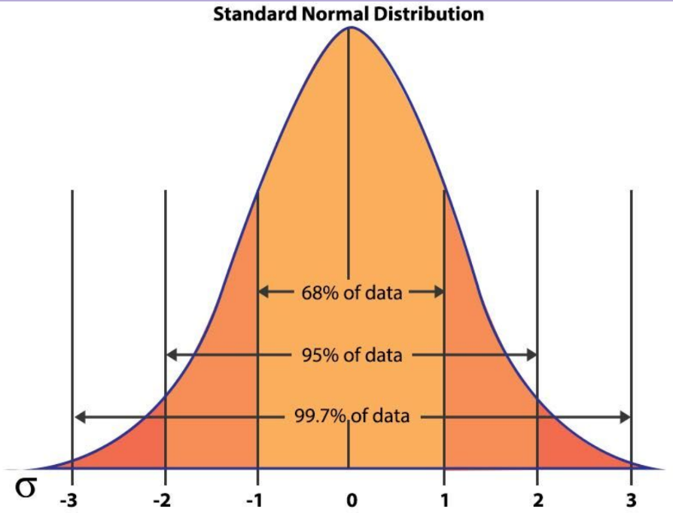
Standard
Normal
Curve

Slide 35
More Practice
Label the Standard Normal Distribution with percentages.
Logan is 63 inches tall. Convert his height to a z-score and plot it.
Erik is 72 inches tall. Convert his height to a z-score and plot it.
Whose height is more extreme? (What does “extreme” mean?)
Kitty’s height has a z-score of 0.786. How tall is she?
Mile’s height has a z-score of -0.452. How tall is he?
Between Kitty and Miles, whose height is less extreme according to their population distribution?
What does a z-score of 0 mean?

Slide 36
Measures of Position
Measures of position tell us the relative location of specific data values.

Slide 37
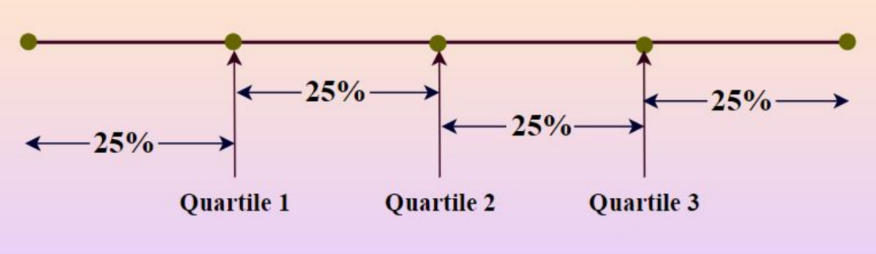
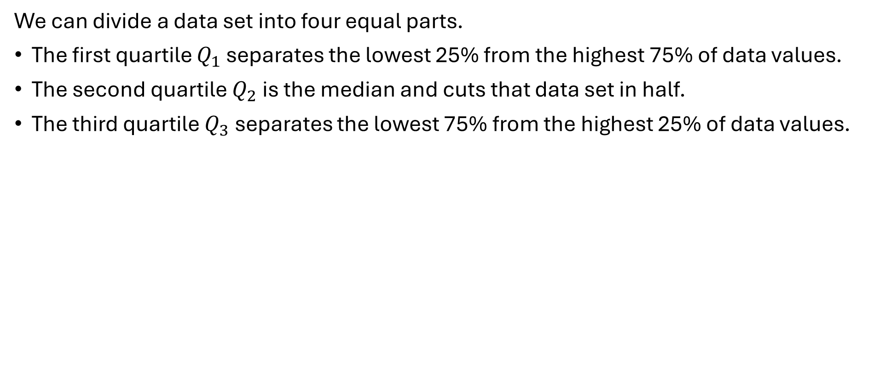
Quartiles
We can divide a data set into four equal parts.
The first quartile $Q_{1}$ separates the lowest 25% from the highest 75% of data values.
The second quartile $Q_{2}$is the median and cuts that data set in half.
The third quartile $Q_{3}$separates the lowest 75% from the highest 25% of data values.

Slide 38
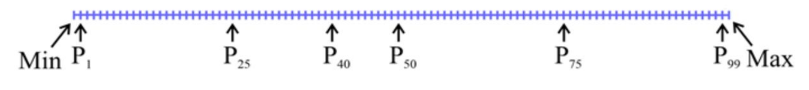
Percentiles
We can also divide a data set into 100 equal parts, called percentiles. (Quartiles are just specific percentiles.)
The pth percentile separates the lowest
p% from the highest (1-p)%.

Slide 39
The 5-Number Summary
The 5-number summary lists the five following values:
minimum, first quartile, median, third quartile, maximum.
MIN—Q1—MED—Q3—MAX

Slide 40
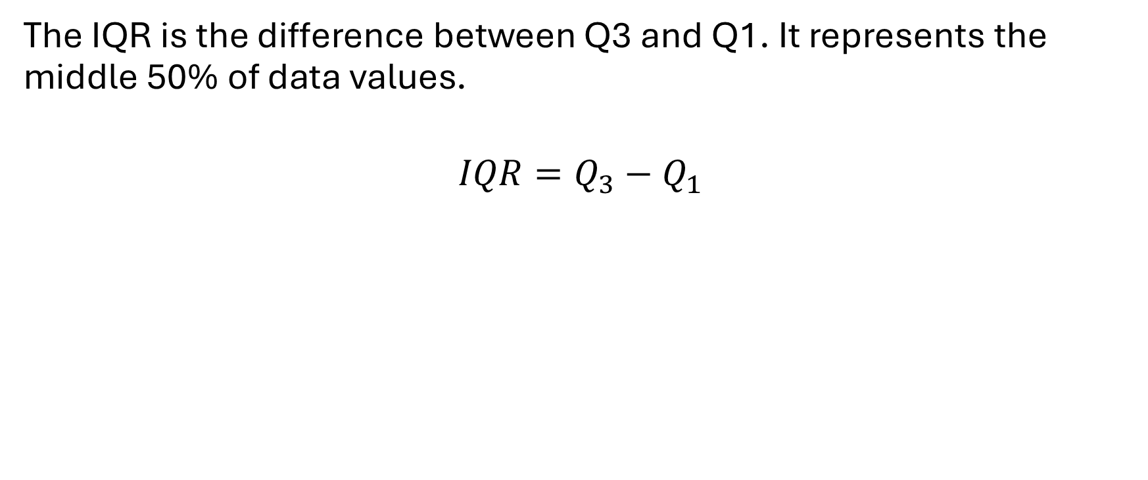
The Interquartile Range
The IQR is the difference between Q3 and Q1. It represents the middle 50% of data values.
$$IQR=Q_{3}−Q_{1}$$

Slide 41
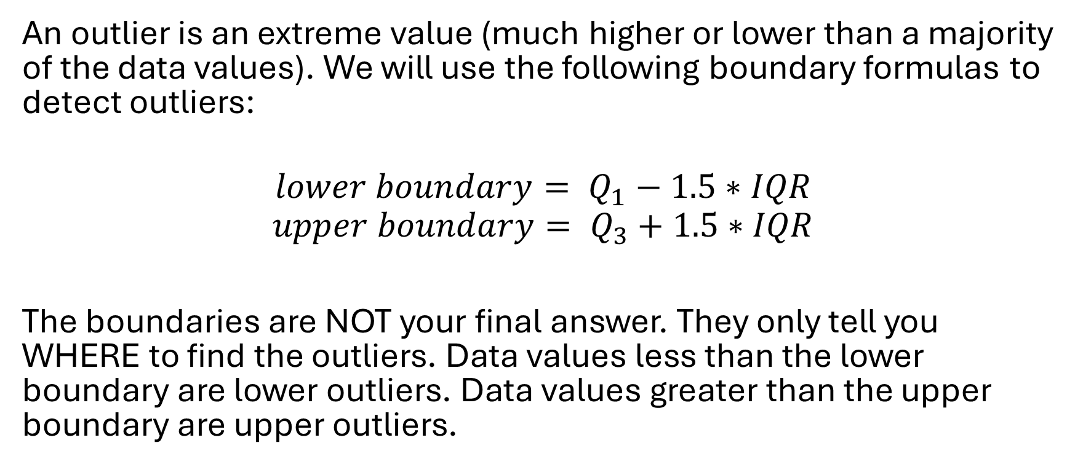
Outliers
An outlier is an extreme value (much higher or lower than a majority of the data values). We will use the following boundary formulas to detect outliers:
$$lower boundary= Q_{1}−1.5∗IQR$$
$$upper boundary= Q_{3}+1.5∗IQR$$
The boundaries are NOT your final answer. They only tell you WHERE to find the outliers. Data values less than the lower boundary are lower outliers. Data values greater than the upper boundary are upper outliers.

Slide 42
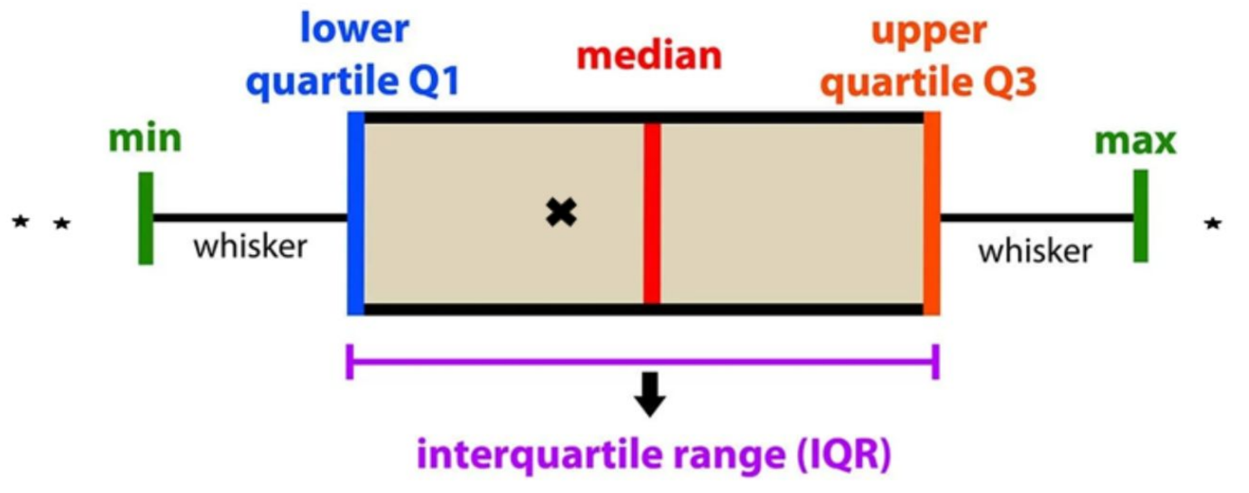
Boxplots (Box-and-Whisker Plots)

Slide 43
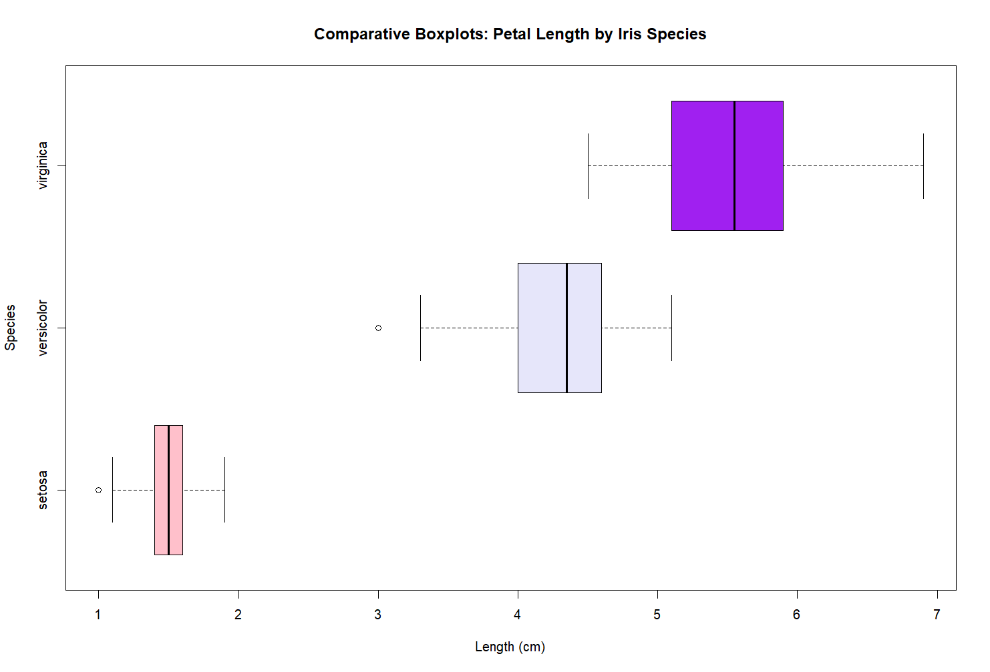
Comparative Boxplots

Slide 44
Boxplots Practice
Create a boxplot for mpg from the mtcars data set.
How would you describe the distribution?
Use comparative boxplots to compare mpg by number of cylinders (cyl). What patterns can we see?

